Slide 1

IT 204
OPERATING SYSTEM DESIGN
Title Here
Multi-threaded Web Scraper
Subtitle
`PROJECT MEMBERS:
NAKUL GUPTA (2K19/IT/084)
NAVEEN YADAV (2K19/IT/089)

Slide 2
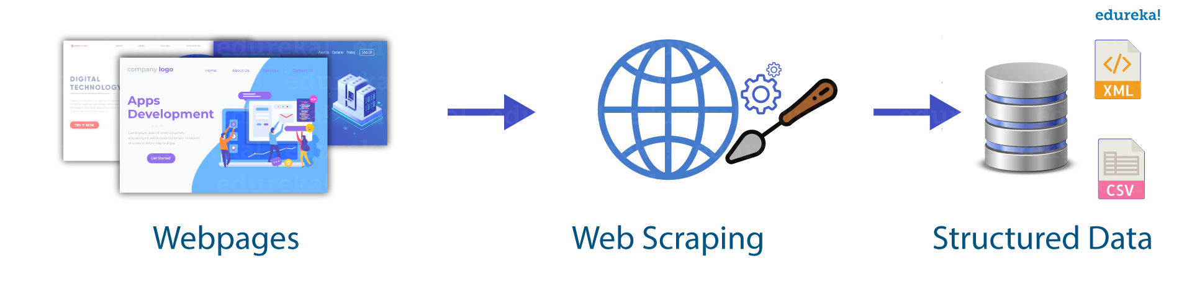
What is Web Scraping?
Web Scraping refers to the extraction of data from a website. This information is collected and then exported into a format that is more useful for the user. Be it a spreadsheet or an API.
Although web Scraping can be done manually, in most cases, automated tools are preferred when scraping web data as they can be less costly and work at a faster rate.
But in most cases, web scraping is not a simple task. Websites comes in many shapes and forms, as a result, web scrapers vary in functionality and features.
<number>

Slide 3
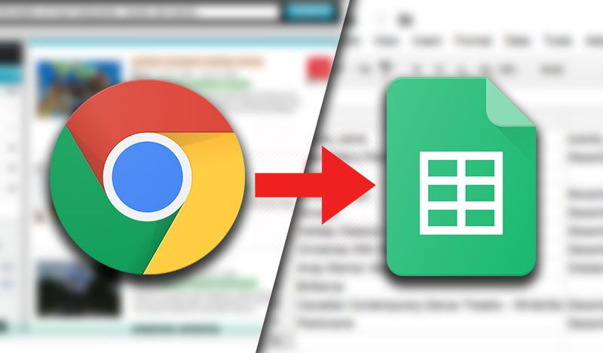
How do Web Scrapers Work?
Automated web scrapers work in a rather simple but also complex way. After all, websites are built for humans to understand, not machines.
First, the web scraper will be given one or more URLs to load before scraping. The scraper then loads the entire HTML code for the page in question. More advanced scrapers will render the entire website, including CSS and Javascript elements.
Then the scraper will either extract all the data on the page or specific data selected by the user before the project is run.
Ideally, the user will go through the process of selecting the specific data they want from the page. For example, you might want to scrape an Amazon product page for prices and models but are not necessarily interested in product reviews.
Lastly, the web scraper will output all the data that has been collected into a format that is more useful to the user.
Most web scrapers will output data to a CSV or Excel spreadsheet, while more advanced scrapers will support other formats such as JSON which can be used for an API.
<number>

Slide 4
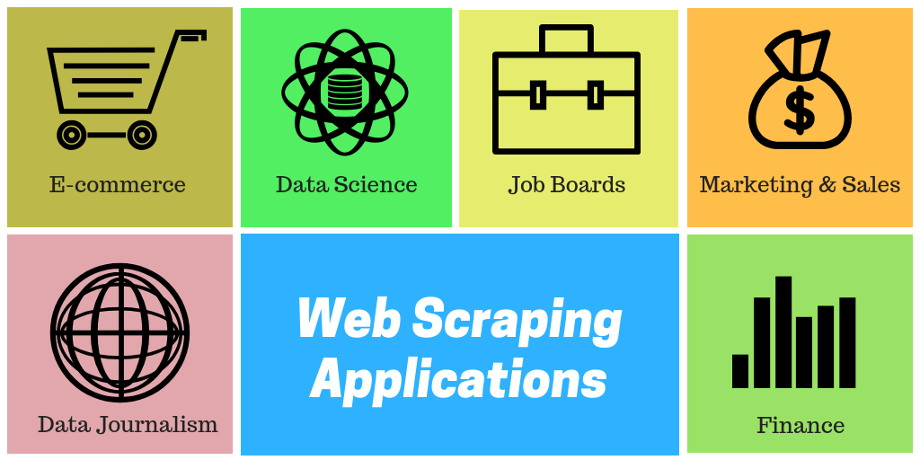
<number>

Slide 5

Why basic Web Scrapping isn’t enough?
Basic web scraping in Python is simple, but it can be time consuming. Multiprocessing looks like the easiest solution, but it can only do so much. Multithreading can speed up web scraping just as easily and usually far more effectively.
<number>

Slide 6
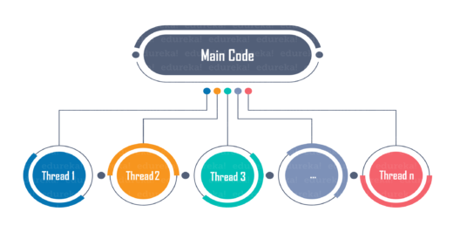
Multi-threading
On a very basic level, a thread is a single process that executes a set of instructions. Multi-threading is the technique of creating multiple threads that run different processes, which can speed up tasks. The number and speed of threads depends on your processor, but having too many threads can sometimes hurt your performance. Multi-threading is sometimes used synonymously with parallel processing, but they are NOT the same.
<number>

Slide 7
Applications of Multi-threading
Threading is used widely in almost every field. Most widely it is seen over the internet now days where we are using transaction processing of every type like recharges, online transfer, banking etc. Threading is a segment which divide the code into small parts that are of very light weight and has less burden on CPU memory so that it can be easily worked out and can achieve goal in desired field. The concept of threading is designed due to the problem of fast and regular changes in technology and less the work in different areas due to less application. Then as says “need is the generation of creation or innovation” hence by following this approach human mind develop the concept of thread to enhance the capability of programming.
<number>

Slide 8
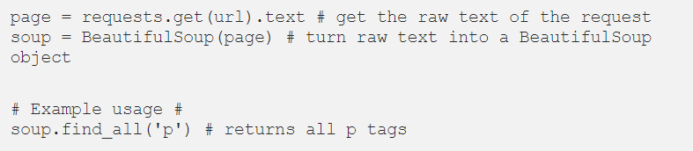

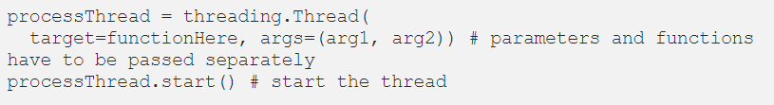
Important Modules
requests
The backbone of this project, we will be using the requests module to send requests and download the webpage. We can fetch a website with the following command :
BeautifulSoup
We will be using BeautifulSoup to parse and search through our downloaded webpage. We can parse the webpage by doing the following:
threading
We will be using this module to handle our multi-threaded downloads.
<number>

Slide 9
Work to be done
Currently we can extract data from one site at a time. In future updates we are trying to scrap data from more than one website at a time by using the concept of multi-threading .
<number>

Slide 10
Thank You

